Slide 1
IDE installations

Slide 2
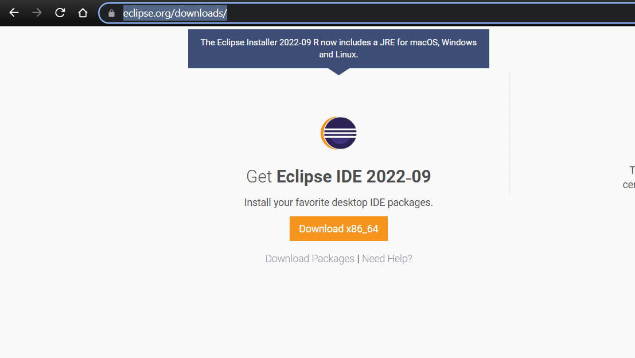
ECLIPSE
Download link: https://www.eclipse.org/downloads/

Slide 3
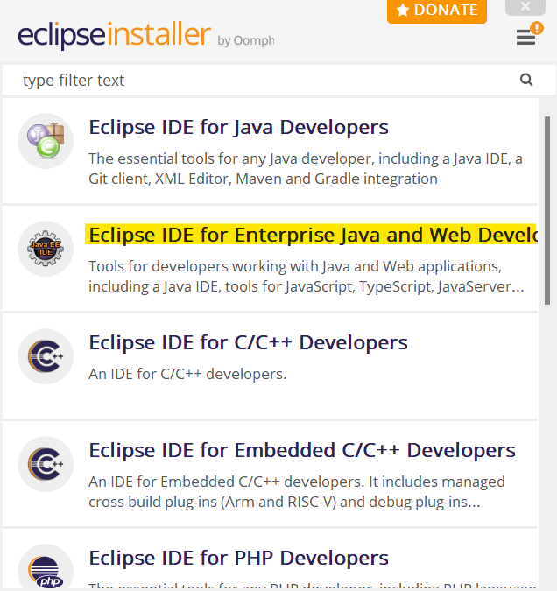
Run the installer
And select Eclipse IDE for Enterprise Java and Web Developers

Slide 4
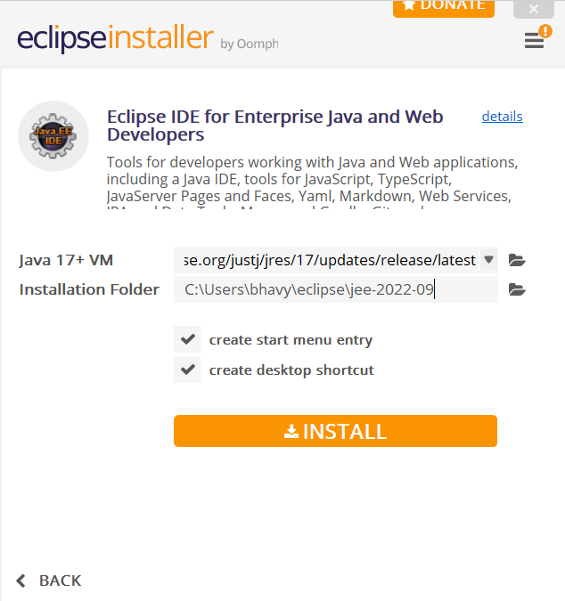
INSTALL
Leave the settings as default and click Install

Slide 5
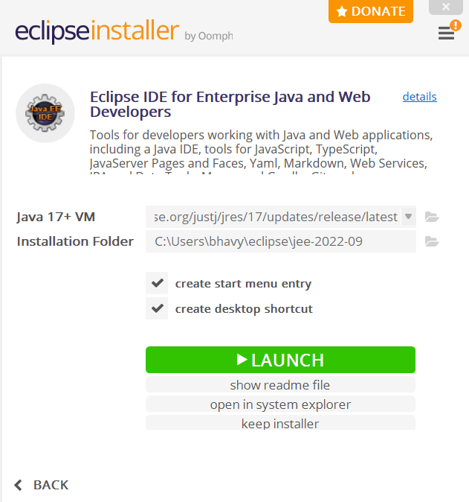
LAUNCH anD OPEN
Click launch to open the IDE

Slide 6
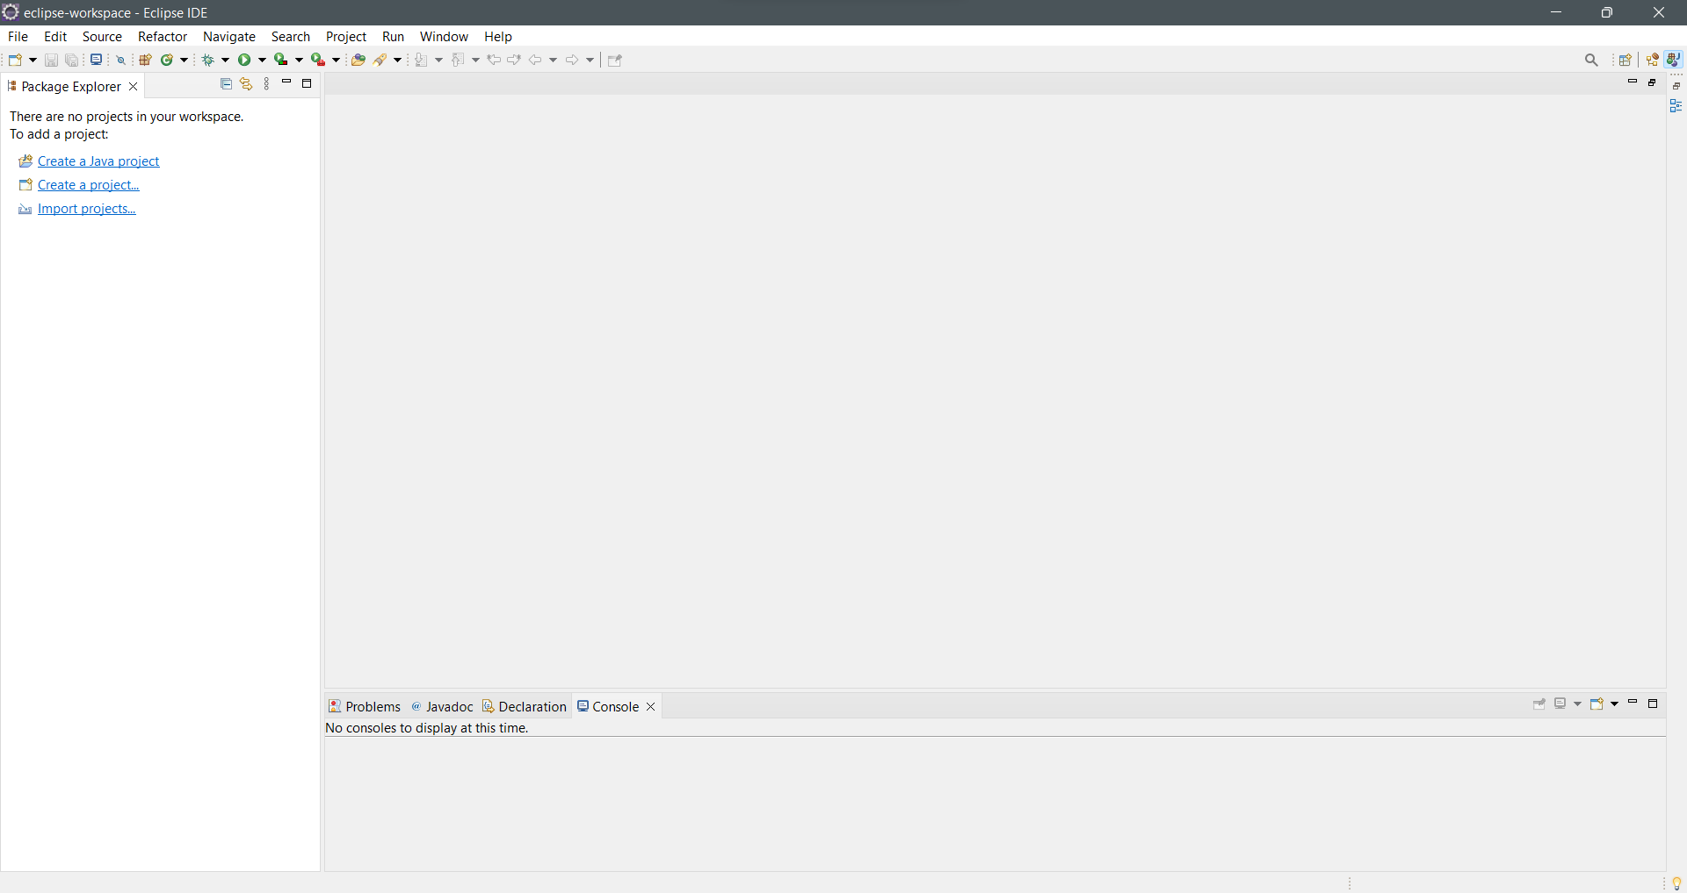
ECLIPSE WINDOW
Once launched, this type of window is seen.
Projects can be created and imported.

Slide 7
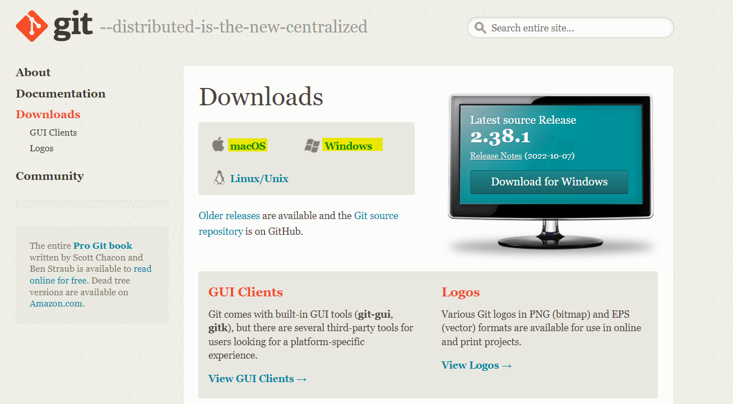
GIT
Download Link: https://git-scm.com/downloads
Choose Windows / Mac / Linux based on operating system

Slide 8
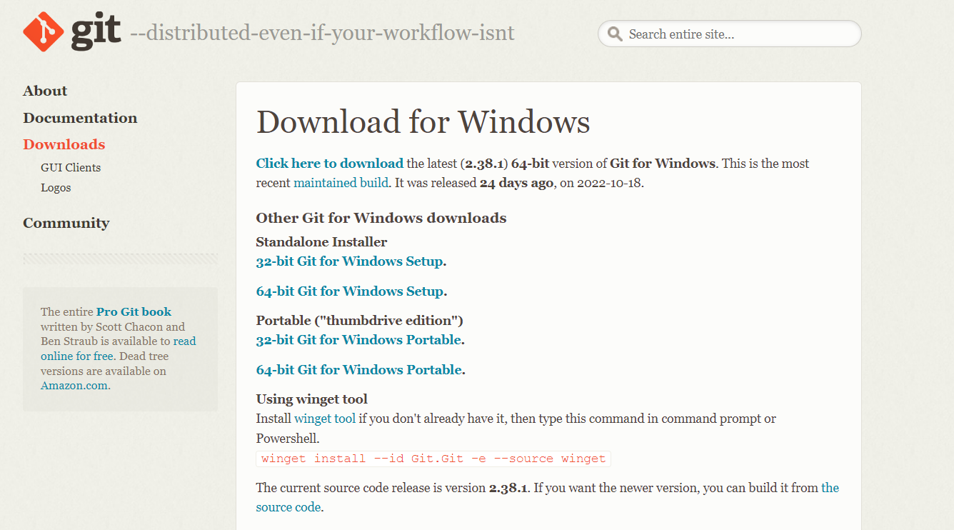
INSTALLERS
For windows – select the configuration of the system and choose the standalone installer

Slide 9
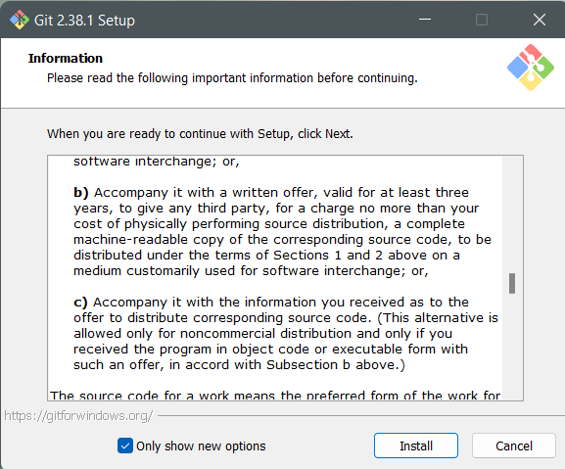
RUN the installer
Run the installer
Click install

Slide 10
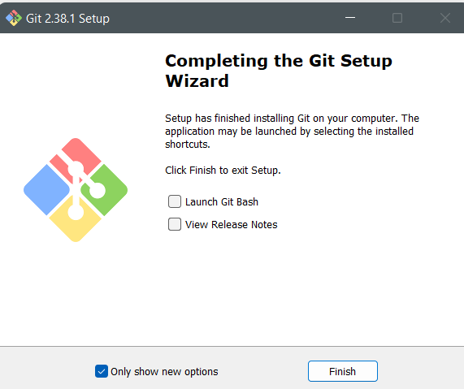
FINISHING INSTALLATION
Click finish to finish installation

Slide 11
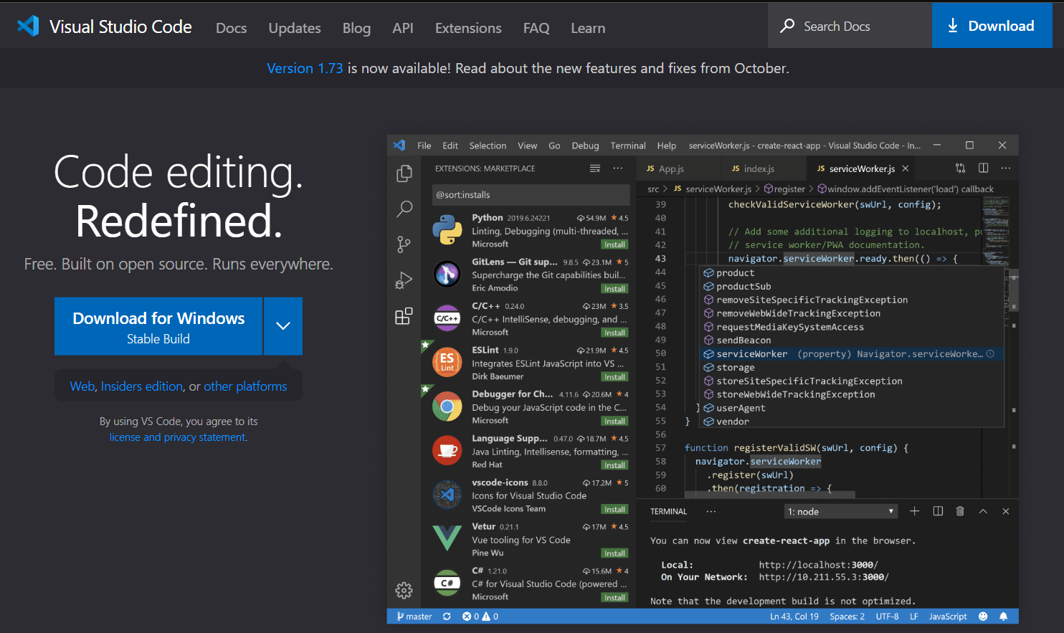
Visual studio code
Download link: https://code.visualstudio.com/
Download the installer based on PC configurations

Slide 12
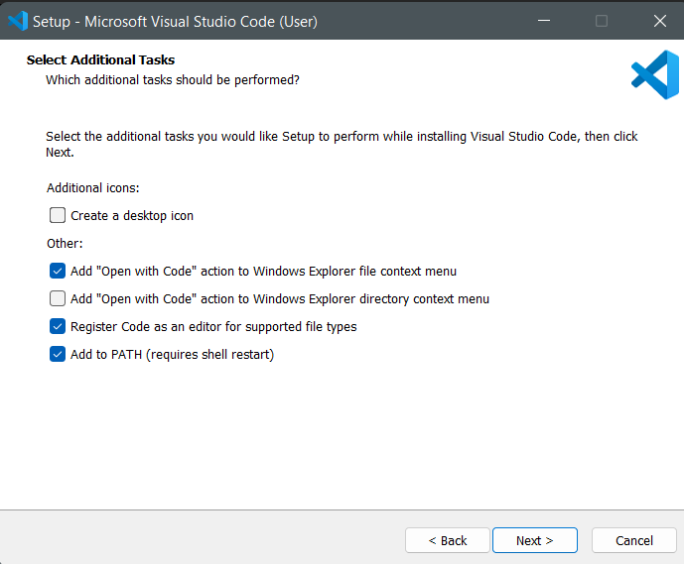
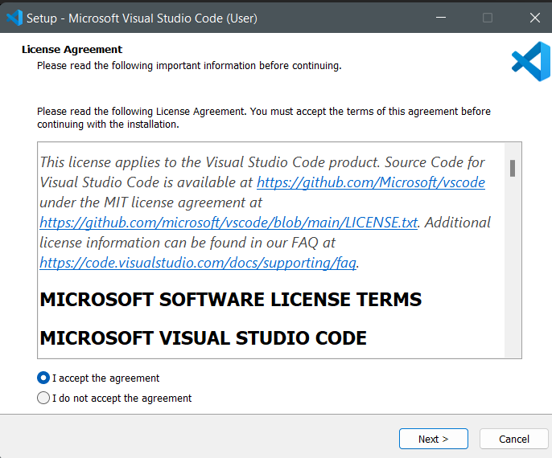

Slide 13
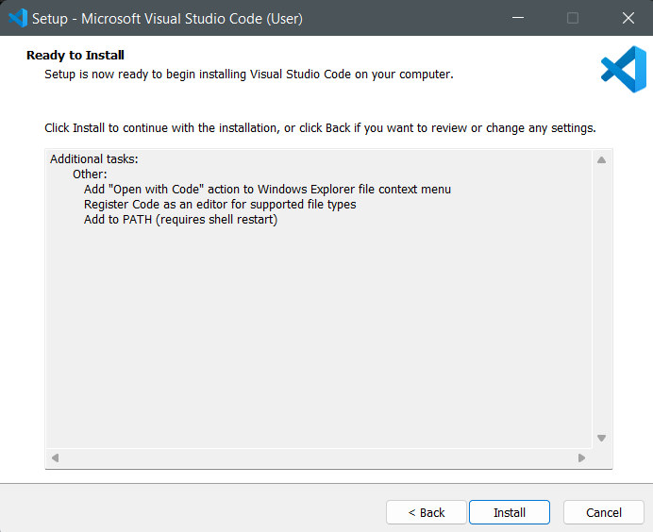
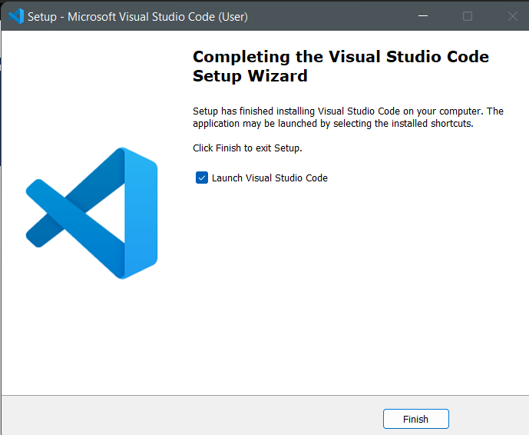
Click install and launch

Slide 14
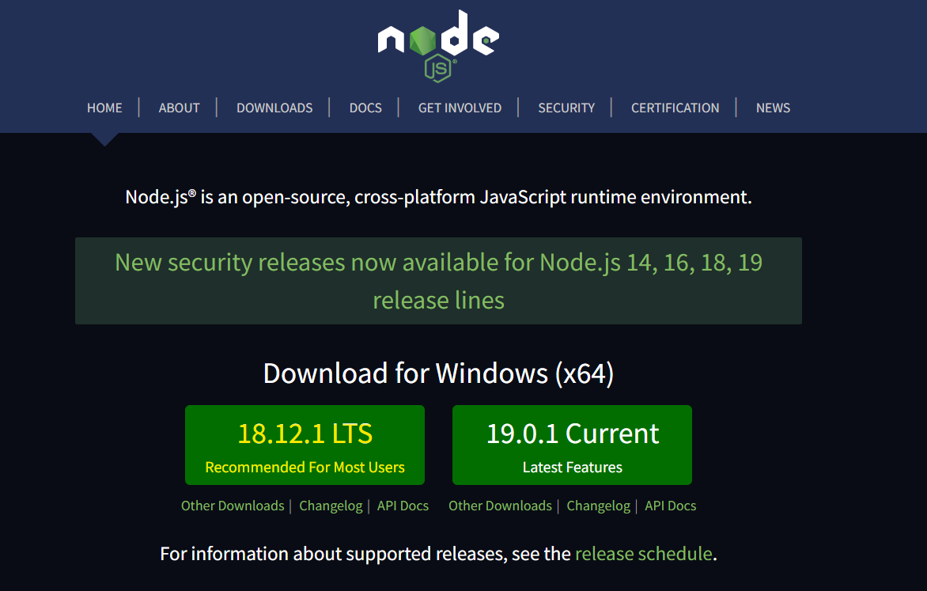
NODE JS
Download link: https://nodejs.org/en/
Use 18.12.1 LTS version

Slide 15
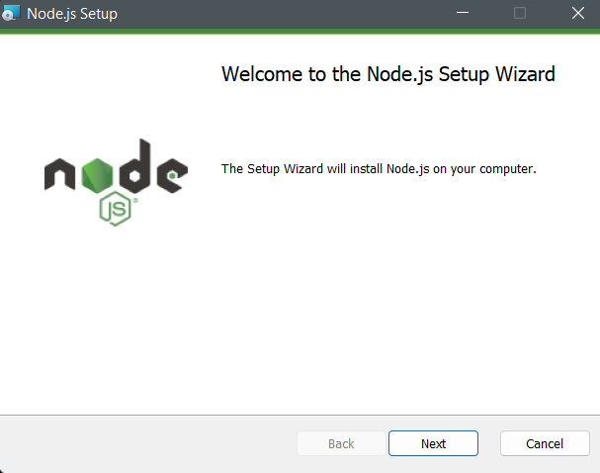
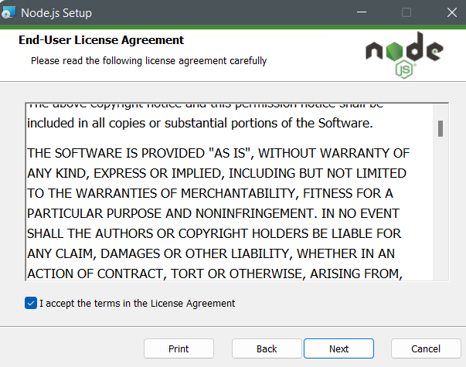
Run the installer

Slide 16
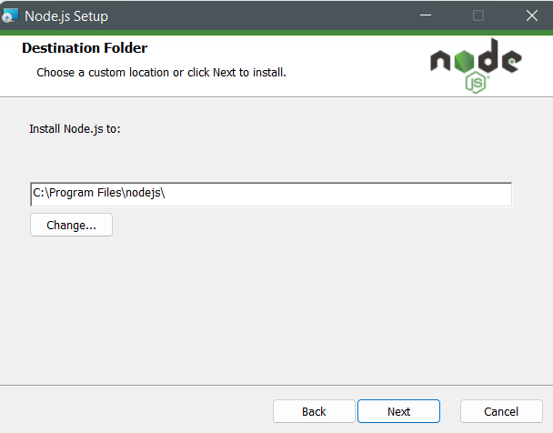
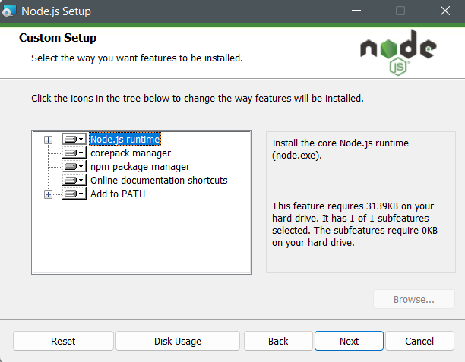

Slide 17
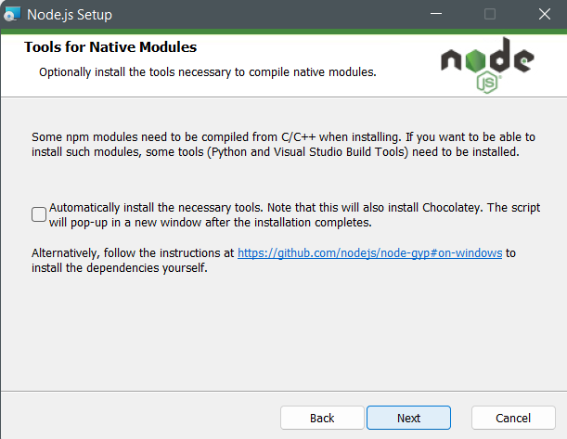
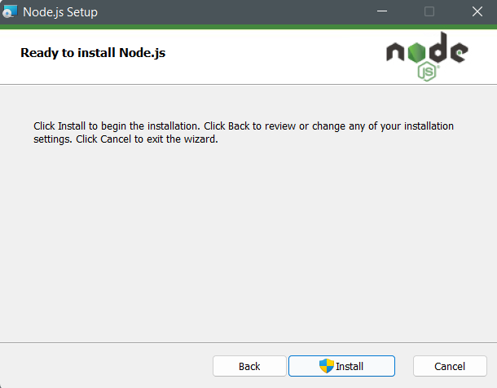

Slide 18
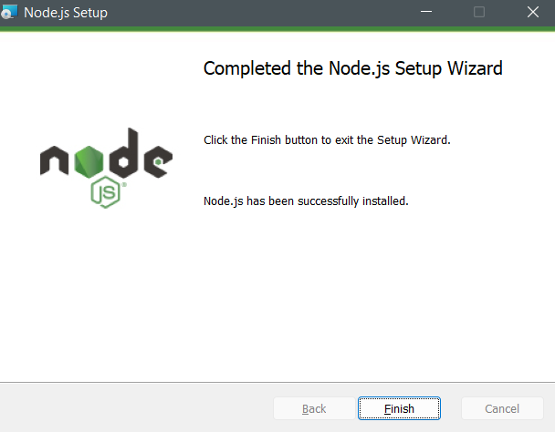
Finishing installation

